Slide 1
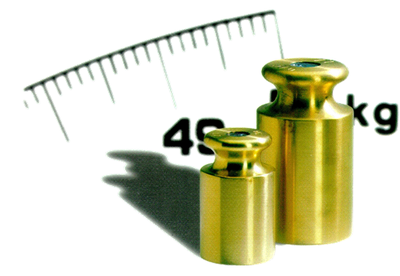
Training for Rinstrum Verification Officers
Welcome

Slide 2
Content of the training
1. Requirements and obligations
1.1 Guidelines and Standards
1.2 New regulationsLaws
1.3 Which prerequisites must be met?
2. The manufacturer's conformity assessment procedure (MCA)
2.1 When may a verification-procedure be carried out?
2.2 Label and seal
2.3 Additional devices
2.4 Gravity acceleration
3. Conformity assesment

Slide 3
Requirements and obligations
1.1 Guidelines and Standards
EU-Regulation
EU- and international Norm
2014/31/EU
2014/32/EU
EN45501
OIML R60 & R76
WELMEC
National Law
DE: MessEG & MessEV
UK: SI 2016 No 1152
PL: Law on conformity assessment systems and market
supervision from 13 April 2016
…

Slide 4
Requirements and obligations
1.2 New regulations
Wordings:
When we talk about a scale, we mean the combination of
indicator and base/bridge!
scale = measuring instrument = weighing instrument = non-automatic weighing instrument (NAWI)
Definition mentioned in the 2014/31/EU:
Weighing instrument’ means a measuring instrument serving to determine the mass of a body by using the action of gravity on that body. A weighing instrument may also serve to determine other mass-related magnitudes, quantities, parameters or characteristics
‘Non-automatic weighing instrument’ or ‘instrument’ means a weighing instrument requiring the intervention of an operator during weighing;

Slide 5
Requirements and obligations
1.2 New regulations
Wordings:
“First Verification” or “First Calibration” is no longer carried out!
The first verification process is now integrated into the conformity assessment process.
By declaring the conformity of a scale with the essential requirements of the relevant EU regulations, especially 2014/31/EU, the newly placed scale is considered equal to a calibrated scale.
Therefore the new processed is called
Manufacturer Conformity Assessment process

Slide 6
Requirements and obligations
1.2 New regulations
Manufacturer Conformity Assesment process
RINSTRUM is the manufacturer of the scale (indicator and bridge)
The MCA process is closed by RINSTRUM, not by the RVO on site !
Therefore the documents have to be sent to RINSTRUM within 5 working days !

Slide 7

Requirements and obligations
1.2 New regulations
The main changes and implications
clearer definition of Economic Operators (manufacturers, authorized representatives, importers and distributors) and their obligations
introduction of analysis and assessment of the risk(s)
improved traceability and co-operation with Market Surveillance authorities
structure and content of the Declaration of Conformity now described in specific Articles and Annexes of the 2014/31/EU
NAWI conformity markings now in line with the current MID markings: Green M replaced by M followed by the last two digits of the year of affixing, surrounded by a rectangle
NAWI Directive harmonized standard will become EN45501:2015 (with EN45501:1994 withdrawn on 20th April 2016) – EC Type Approval Certificates will remain valid, but additional testing and examination may be required when the certificates are renewed or revised
manufacturer’s (and importer’s when applicable) full address must appear on the instrument
importers and distributors can become the manufacturer if they place an instrument on the market under their name or modify an instrument already placed on the market
M20 0122

Slide 8
Requirements and obligations
1.3 Which prerequisites must be met?
Conclusion of a contract between Rinstrum Europe GmbH and the company of the assigned person
Proof of liability insurance (company of the authorized person)
Participation of authorized persons in internal trainings on the manufacturer's conformity assessment procedure
(Also retraining at less than 10 MCAs per year)
Successful passing of the theoretical and practical exam
The basis for all transactions is valid law
Well known and at hand:
-All relevant EU-regulations (2014/31/EU) and national law
-All relevant Norms EN 45501:2015, OIML and WELMEC

Slide 9
Requirements and obligations
1.3 Which prerequisites must be met?
Work instruction - Initial Verification Procedure (X00A-803)
Work instruction - Verification Test (X00A-804)
Work instruction - Flowchart (X008-809)
Template - Verification of Compatibility (X00A-805)
Template - Test Report (X00A-822)
Template - Check List for the Execution of First Verification (X00A-808)
Template - Declaration of Conformity (X00A-821)
Template – Rinstrum internal: Conformity Check (X00A-807)
The templates used for all documents must be up-to-date, it is your responsibility.
Updates will be notified via email newsletter.

Slide 10
Requirements and obligations
1.3 Which prerequisites must be met?
Type Approval Certificate (TAC) for the used load cell
OIML R60 certified
Calibration Certificate for the used weights
(documenting the traceability to national standards)
If weights or calibration vehicle have been rented, contract on the loan must be present
All documents must be stored securely for 10 years (as data or on paper)

Slide 11

Manufacturer Conformity Assessment
2.1 When may an verification-procedure be carried out?
Manufacturer Conformity Assessment or calibration?
A scale was built up with new components. All calibration requirements are met.
A scale was rebuilt with used components. All calibration requirements are met.
The scale has already been placed on the market and has never been evaluated for conformity. All calibration requirements are met.
MCA
During a repair, metrologically relevant components were replaced.
During a repair, the indicator unit was replaced by a new one with a different type approval, e.g. R320 against C520

Slide 12
Manufacturer Conformity Assessment
2.1 When may an verification-procedure be carried out?
in all other cases ...
... after a change in values or components of relevance to legality
... after a repair, replacement with same components
... or a remodeling with a seal injury ...
…or after firmware update with changes of relevance to legality
... a calibration has to be carried out by the respective calibration office.

Slide 13

Manufacturer Conformity Assessment
2.2 Label and seal – OLD VERSION
Trade Label
X00A-304 (520028)
Certification Label
X00A-302 (520030)
Do not use any more !
Verification Seal
large (520032)
Verification Seal
small (520033)
Transparent Seal
(5200xx)

Slide 14
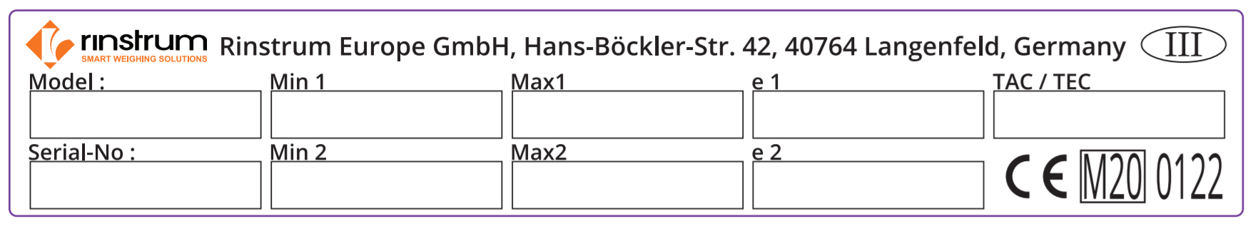
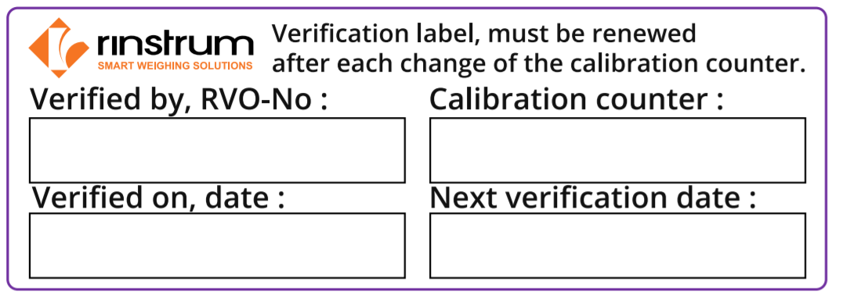

Manufacturer Conformity Assessment
2.2 Label and seal
Trade Label RVO 2020
X00A-304-201 (A11030-20)
Certification Label
X00A-302-201 (A11047)
Certification Seal
X00A-305-101 (A11029)
Transparent Foil
X00A-306-100 (A11037)
New Stockcode LABEL-KIT for set of labels for 1 Scale.
  5 x Certification Seal
  1 x Trade Label RVO 2020
  1 x Certification Label
  2 x Transparent Foil

Slide 15



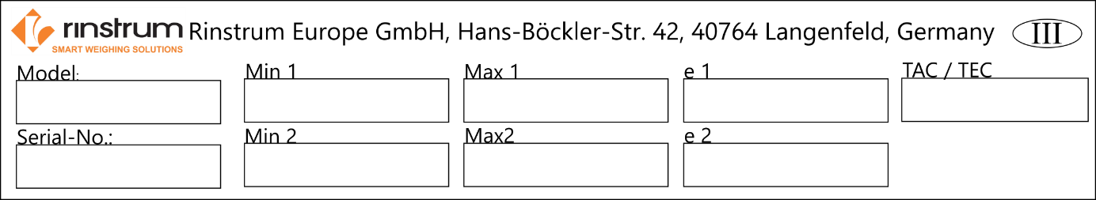

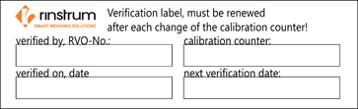

Manufacturer Conformity Assessment
2.2 Label and seal
How to put label and seal on the indicator

Slide 16

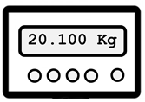
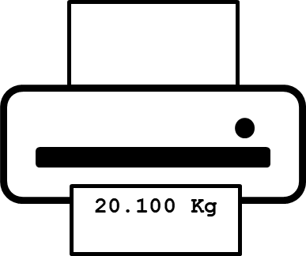

Manufacturer Conformity Assessment
2.3 Additional devices
20.100 Kg
not legal for trade
verifiiable
20.100 Kg
alibi memory
and/or
protocol printer
Schulung zur Hersteller-Konformitätsbewertung
legal for trade
Notes:
16

Slide 17

Manufacturer Conformity Assessment
2.3 Additional devices
20.100 Kg
The following note is required:
"Measured values from non-calibrated additional equipment.
The calibrated measured values can be viewed. "
alibi memory
and/or
protocol printer
Be transmitted:
weight, gross, tare, net, date, time
and alibi memory number
The data can be processed in a non-calibrated PC system. Traceability of the values is given by the alibi memory number.
Schulung zur Hersteller-Konformitätsbewertung
Notes:
17

Slide 18

2. Das HKB-Verfahren
Manufacturer Conformity Assessment
2.4 Gravity acceleration
Consideration of gravity acceleration
If a scale is not adjusted at the site,
the g-value place of use must be entered before delivery.
The necessary accuracy of the g-value input depends
by the number of scale intervals (d).
WELMEC regulation: http://www.welmec.org/welmec/gravity-information.html
Determining exact g-values: http://www.ptb.de/cartoweb3/SISproject.php
Schulung zur Hersteller-Konformitätsbewertung
Notes:
18

Slide 19

Training for Rinstrum Verification Officers
Thank You!

Slide 20
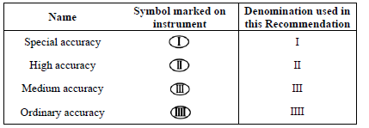
General Information DIN EN 45501-2015
Accuracy classes
Classification of instruments
Accuracy class | Verification scale interval, e | Number of verification scale intervals, n = Max/e |  | Minimum capacity, Min (Lower limit)
 |  | minimum | maximum
Medium (III) | 0.1 g ≤ e ≤ 2 g | 100 | 10 000 | 20 e
 | 5 g ≤ e | 500 | 10 000 | 20 e
Ordinary (IIII) | 5 g ≤ e | 100 | 1 000 | 10 e

Slide 21
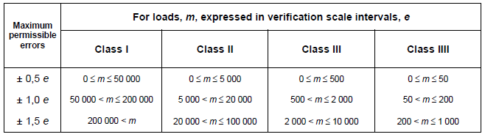
General Information DIN EN 45501-2015
Maximum permissible errors

Slide 22
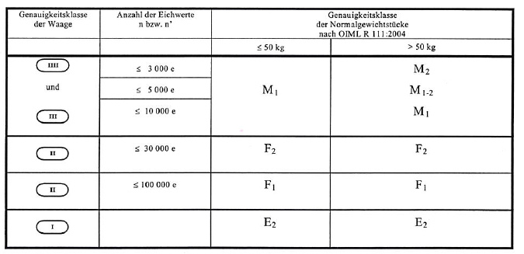
Standard weights
Accuracy of standard weights according to OIML R 111:2004

Slide 23
X00A-803-160 Procedure
Find / prepare the “Verification of Compatibility for Modules of Weighing Instruments” using spreadsheet X0A-805. Ensure that the modules are compatible.
Find the correct Test Report (X00A-822) dependent upon scale type / weigh bridge, Max. load and number of ranges, according to work instruction X00A-804 and corresponding to DIN EN 45501.
Check that indicator will show OLOAD if the load is more than 9e over Max. At the end of the tests for Test Report, HI_RES should be switched off before the calibration counter is recorded.
Affix the verification labels. Ensure they are filled out correctly. Stick the transparent foil over the verification labels for protection. It is allowed to print the trade label RVO ( X00A-304) onto an adhesive foil (e.g. L6013 from Zweckform or destructable foil). Seal all the affixed labels.
Photograph all the sealed labels as well as the sealed junction box.
Complete the Check list for the Execution of First Verification X00A-808.

Slide 24
X00A-803-160 Procedure
Store the test data:
  The following documents - eventually they have to be scanned - must be stored on the Rinstrum server in the subdirectory of the Verification Officer:
  X00A-805 / X00A-822 / X00A-808 / photos / copy of a certificate of used standard weights / copy of a certificate of the used delta-weights
  The filename should be:
  SheetNumber_Series of Indicator_SerialNumber_VerificationOfficer
  e.g. “X00A-816_R320-K306_3131313_rvo12121.pdf”.
  If off-site, email the scanned files to verification@rinstrum.com with the following details in re.:
  “Series of Indicator_Indicator-SerialNumber_SerialNumber of Scale_RVO-No.”.
  The data must be unzipped. Only data of one scale may be attached to one mail.

Slide 25
X00A-803-160 Procedure
Attention: The documents have to be sent in maximum 4 weeks after performing the tests and affixing the labels. Otherwise we can’t issue a declaration for that scale anymore.
Rinstrum will issue a Declaration of Conformity and it will be stored at Rinstrum EU together with the other documents of the scale. Rinstrum will ensure that the test officer gets a scanned pdf of the declaration asap. This pdf will also be valid like the original. The original document will be sent to the RVO at the end of the appropriate month.
Send the Declaration of Conformity as pdf or/and original to the customer.
According to national law, if requested, RVO should ask the customer for informing the local authority about the verified scale and sending all requested documents.

Slide 26
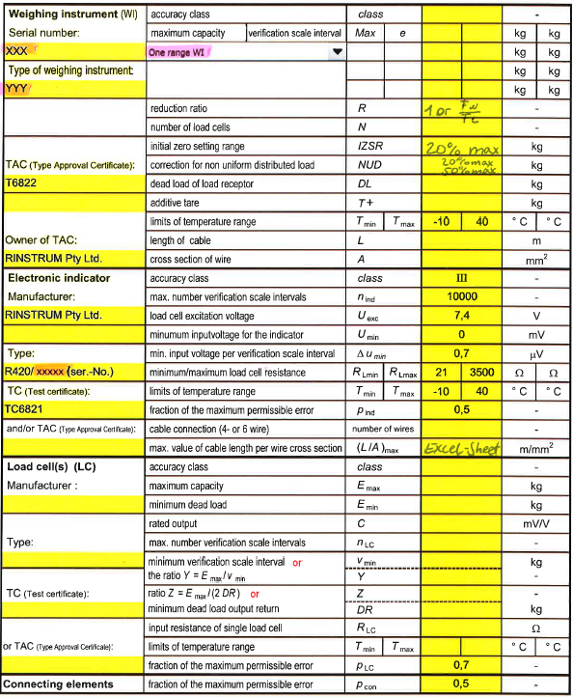
KompMod

Slide 27
X00A-804-270 Verification tests
Verification tests
The tests should be conducted in accordance with DIN EN 45501-2015
During the tests the indicator shall be set in high resolution mode (HI_RES). Only for the tests for accuracy of zero- and tare-device, the HI_RES-Mode shall be switched off. The results shall be recorded in the Test Report X00A-822.
Please select the appropriate sheet regarding to the tested scale. At the top of each sheet the language English or German can be chosen. All orange data fields have to be completed. Set no. of the used standard weights and no. of the used small delta-weights (used e.g. for test of Zero, Tare, Discrimination) must be recorded in the header.
At the beginning of each test ensure that the scale is in its reference position (not tilted), i.e. the bubble is in the center of the marked circle. The tests should be performed at a steady ambient temperature.
Eccentricity for Dual range scale should be tested at 1/3 of Max2
In case, a printer is connected, the printout should be checked.

Slide 28
X00A-804-270 Verification tests
Substitution of standard weights at verification (for Max.>1t)
When testing instruments at the place of use (application), instead of standard weights any other constant load may be used, provided that standard weights of at least 50% Max are used. At a load of about the value where the substitution is made (but at least 50% Max), the repeatability test should be passed.
If it isn’t allowed to transport more than 20t of weights on the roads, like in Hungary, it is permitted to do Repeatability Test for a scale with Max up to 60t with a contingent of only 20t standard weights. Provided that the max.error in Test 1 is not more than 0,2e. Repeatabitlity Test must then be performed at a total load of about 50% Max, made up of the standard weights + Truck + substitution material.
If the max. error is not more than 0,3e the portion of standard weights may be reduced to 35% Max
If the max. error is not more than 0,2e the portion of standard weights may be reduced to 20% Max
Procedure for using substitution material is the following:
Put the contingent of standard weights onto the scale that you would like to substitute. Note down which weight the indicator shows. Then load substitution material onto the scale until the indicator shows exactly the same weight. After that, gently add the standard weights up to the next test load. Same procedure would be downwards.

Slide 29
X00A-804-270 Verification tests
Test 1: Repeatability Test
The instrument’s automatic zero-setting and zero-tracking device may be in operation during this test.
Before testing repeatability the scale has to be pre-loaded with Max.
At least three weighings with about 80% Max are necessary.
If Max. is more than 1t, it will be allowed to test repeatability with load of 50% Max.
Readings shall be taken and recorded when the instrument is loaded.
It is allowed to zero the instrument between the weighings, if it doesn’t show zero.
The error between the three readings shouldn’t be more than the absolute value of the permissible error.

Slide 30
X00A-804-270 Verification tests
Test 2: Accuracy of zero device
High-Res Mode must be switched off.
For this test a weight near to Zero (Zero tracking should be turned off) must be loaded onto the scale
Indicator must now be set to Zero by pressing the Zero-button
Standard weights of 1/10e must be gently added, until indication changes from one scale interval to the next above. Please note down the number of added weights.
Now evaluation of Error at Zero is calculated in the sheet according to the following formula:
E = 1/2e – ΔL (ΔL: added load)

Slide 31
X00A-804-270 Verification tests
Test 3: Accuracy of tare device
High-Res Mode and Zero tracking must be switched off.
This test is to be performed in the same manner like Test 2.
A weight close to Zero must be loaded onto the scale, e.g. 10e.
Indicator must be tared by pressing the Tare-button.
Standard weights of 1/10e must be gently added, until indication changes from one scale interval to the next above.
Evaluation of Error is calculated in the sheet.

Slide 32
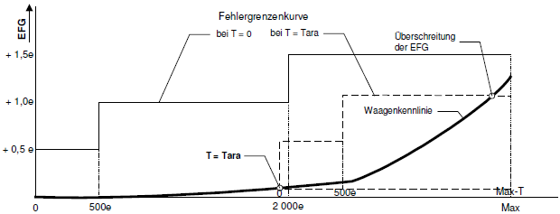
X00A-804-270 Verification tests
Test 4: Weighing / Linearity Test
Zero-setting or zero-tracking device shall not be in operation.
Apply at least 5 test loads and similarly remove them back to zero. The loads selected shall include Max and Min and values at or near to those at which the maximum permissible error (mpe) changes (500e and 2000e). The scale should not be allowed to return to zero between loads.
If substitution material is used, you must first load from zero up to the maximum quantity of standard weights. Then remove the weights and substitute the previous weights with substitution material. Repeat the procedure until Max is reached. Unload in reverse order to zero.
The calculation sheets calculates the total error E_{error} - E_{zero.} If this total error is less or equal to 0,5e, Tare Test 5 has not to be performed.

Slide 33
X00A-804-270 Verification tests
Test 5: Tare (Weighing Test)
The Test Report sheet calculates if this Test has to be undertaken or not.
This test has to be performed if the total error in Test 4 is more than 0,5e.
Zero-setting or zero-tracking device shall not be in operation.
A load between 1/3 and 2/3 Max should be applied and then be tared.
Apply at least 5 test loads and similarly remove them back to zero. The loads selected shall include Max and Min and values at or near to those at which the maximum permissible error (mpe) changes (500e and 2000e). The scale should not be allowed to return to zero between loads.
If substitution material is used, you must first load from zero up to the maximum quantity of standard weights. Then remove the weights and substitute the previous weights with substitution material. Repeat the procedure until Max is reached. Unload in reverse order to zero.

Slide 34
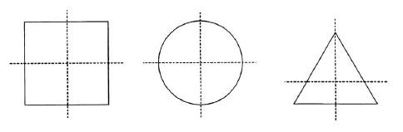
X00A-804-270 Verification tests
Test 6: Eccentricity Test
Zero-setting or zero-tracking device shall not be in operation.
Large weights should be used.
For an instrument with a load receptor having not more than four points of support, the four quarter segments roughly equal to ¼ of the surface of it shall be loaded in turn. The test load shall be 1/3 Max.
For an instrument with a load receptor having more than four points of support, the test load of 1/n-1 Max shall be applied over each support on an area of 1/n of the surface area of the load receptor.
Where two points of support are too close together for this test load, the doubled load shall be distributed over twice the area on both sides of the axis connecting the two points of support.

Slide 35
X00A-804-270 Verification tests
Test 7: Test with coasting load
A truck load of at least 50% Max but not exceeding 80% Max shall be driven onto the weighbridge from each of the access roads. Measurements shall be carried out in each of the three bridge segments. The distance from the middle position to the first or end position shall be more than 0,1B, where B is the length of the bridge.
Test 8: for special application
Earth Gravity
If necessary, verify the earth gravity for the place of use.
Place of installation
Name and town of the installation.

Slide 36
X00A-804-270 Verification tests
Calibration Counter
The high resolution mode (HI_RES) shall be switched off. Then calibration counter should be recorded.
X00A-822-266 M01.xls

Slide 37
Checklist X00A-808-160
What to be checked:
Copies of the Standard DIN EN 45501-2015 and Directive 2014/31/EU present.
Is the Initial Verification executed according to the National laws and Guidelines in the Country of Installation?
Visual inspection of the scale in accordance with the Initial Verification Procedure X00A-803, issue 1. OK.
Scale is according to 2014/31/EU. Documentation on hand / with the product
If printer is connected, the printout is checked and ok
Test certificate for the Load Cell at hand; a photocopy made
Calibrated weights in use, i.e. Calibration Certificates for the weights present. Certificates of Delta-weights must be sent once a year.
Verification of Compatibility for Modules of Weighing Instruments X00A-805 successful.
Initial Verification Procedure X00A-803 followed.
Verification Tests X00A-804 implemented.

Slide 38
Checklist X00A-808-160
What to be checked:
Test Report for the Verification Tests X00A-822 filled and assessed.
Rinstrum Destructible Labels stuck on the junction box and the load cell connection in the Indicator as well as on two screws of the Indicator casing to safeguard warranty; photos made.
Rinstrum Certification and Trade Label stuck on weighing Instrument; sealed with the Rinstrum Destructible Labels; photos made.

Slide 39
Checklist X00A-808-160
Application for the Declaration of Conformity sent to Rinstrum Euope GmbH: Per Email (verification@rinstrum.com) as PDF-files
Photocopies of the Test Certificate for the load cell, of the calibration certificates for the calibrated weight-sets mentioned in the test report, of the Verification of Compatibility for Modules of Weighing Instruments X00A-805 and of the Initial Verification Test Report X00A-822;
Photo of the complete scale with standard weights on load receptor.
Photos of the Indicator with Rinstrum Certification and Trade Label on, sealed with Rinstrum Destructible Labels;
Photos of the load cell connection in the Indicator and of the Junction box sealed with Rinstrum Destructible Labels;
Photocopy of this Check List for the Execution of First Verification - filled and signed..

Slide 40
Training for Rinstrum Verification Officers
Thank You!

